Slide 1







Prompt Wrangling: On Replication and Generalization in Large Language Models for PCG Levels
Arash Moradi Karkaj
Mark J. Nelson
Ioannis Koutis
Amy K. Hoover
Foundations of Digital Games 2024
Worcester Polytechnic Institute

Slide 2
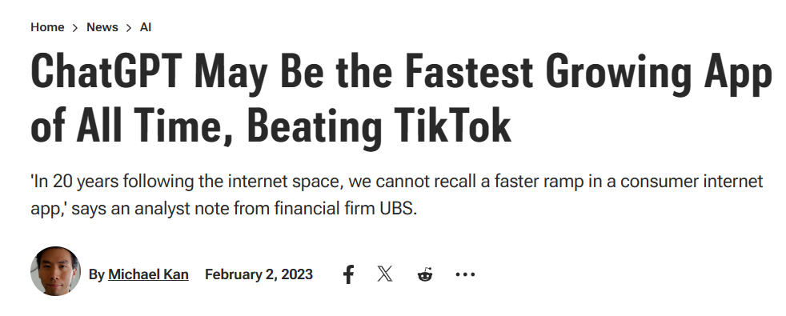
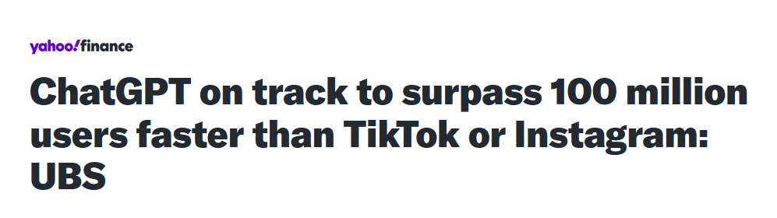
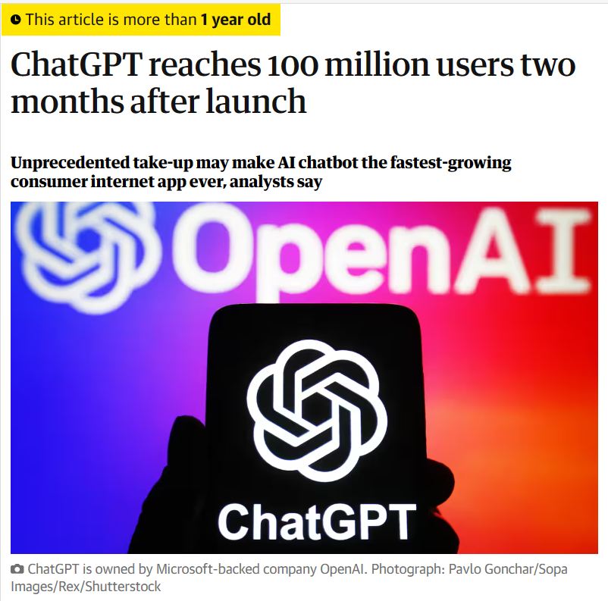
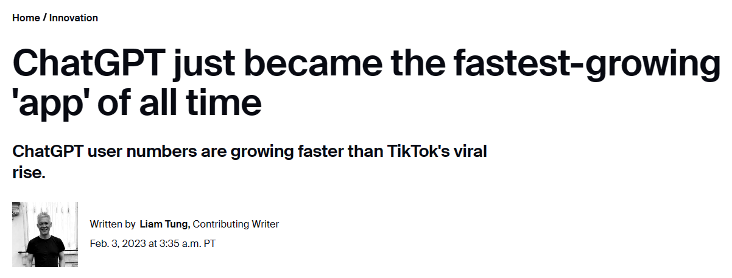
ChatGPT is Popular
Notes:
LLMs are popular in the mainstream
ChatGPT took over as an app
2024-05-13 (amy):
Remove Introduction

Slide 3
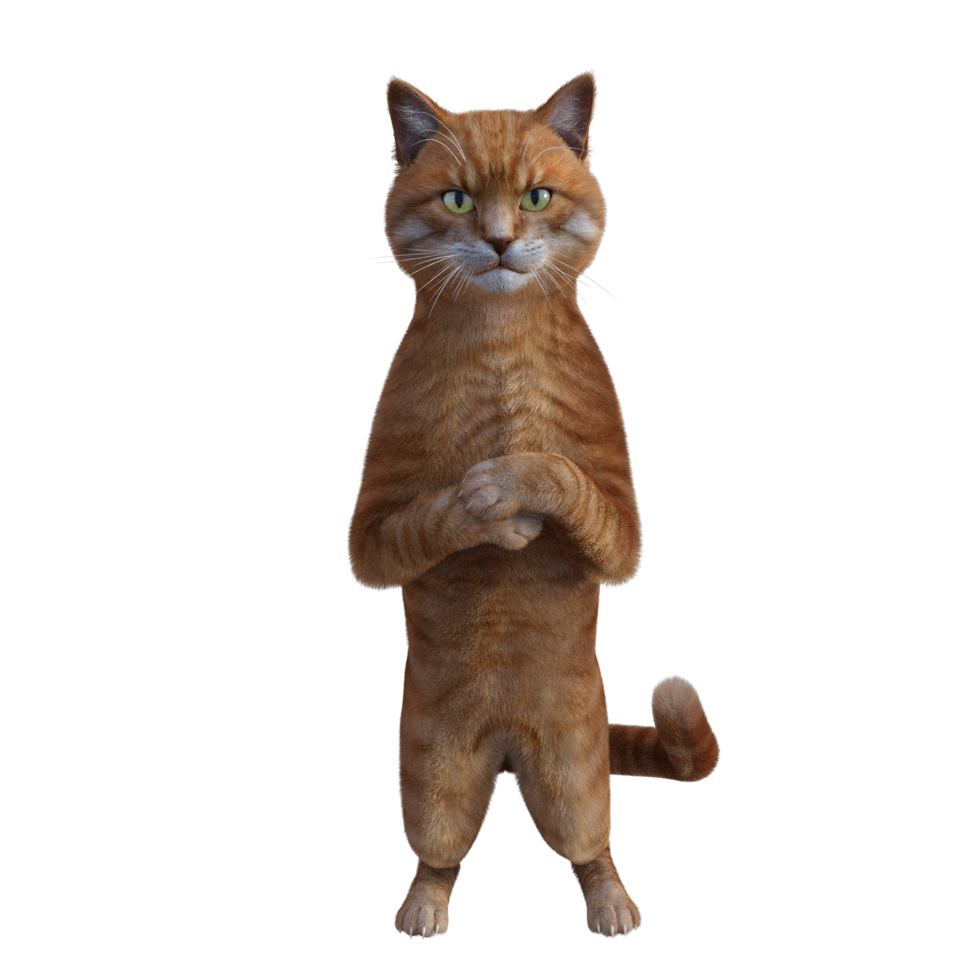

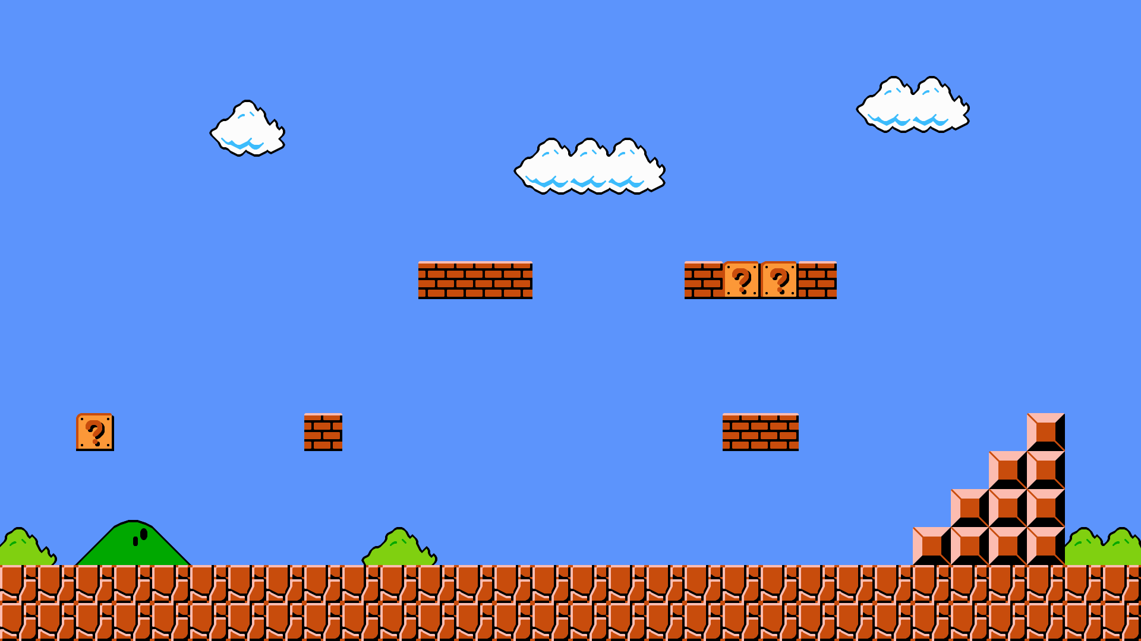

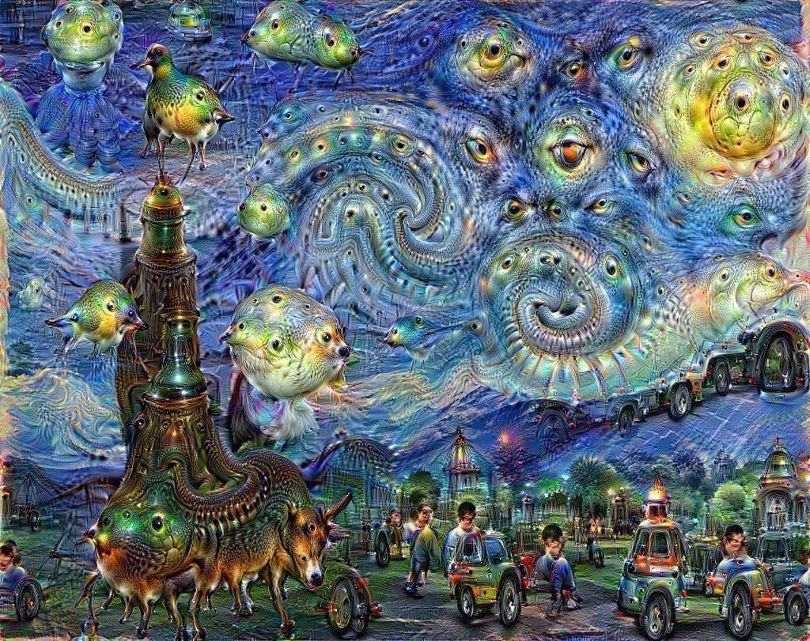
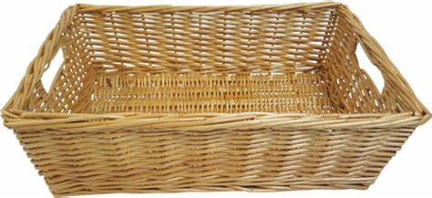
Generative Models are hot.
MusicGen
OpenAI Codex
Deep Dream
Stable Diffusion
Large
Language
Model
prompt
Notes:
2024-05-13 (amy):
Idea One: omg the whole world is finally as excited as we are to generate basket stuff.
Idea Two: We are so excited by LLMs that we are trying to work it into the ES paradigm, LLM Sebastian and Julian.
2024-05-13 (amy):
Remove Introduction

Slide 4
Why Wouldn’t They Be: Give Users Control Over Content
Show Several Examples of How Humans Control the Output of Some of these Models
We as humans get to control the output that we generate with natural language
Notes:
2024-05-13 (amy):
Idea One: omg the whole world is finally as excited as we are to generate basket stuff.
Idea Two: We are so excited by LLMs that we are trying to work it into the ES paradigm, LLM Sebastian and Julian.
2024-05-13 (amy):
Remove Introduction

Slide 5
LLMS to Generate Levels
We can generate levels with natural language text as a prompt. MarioGPT works.
But, there are some kinks to work out as you must be precise for LLM tools like MarioGPT
Notes:
2024-05-13 (amy):
Idea One: omg the whole world is finally as excited as we are to generate basket stuff.
Idea Two: We are so excited by LLMs that we are trying to work it into the ES paradigm, LLM Sebastian and Julian.
2024-05-13 (amy):
Remove Introduction

Slide 6
ChatGPT4PCG Competition 2023
LLMs/Generative Models are hot
Systems often designed with control-through-prompting in mind
Competition in some sense is looking at how we can best design prompts to generate the levels that we want to see.
Notes:
2024-05-13 (amy):
Idea One: omg the whole world is finally as excited as we are to generate basket stuff.
Idea Two: We are so excited by LLMs that we are trying to work it into the ES paradigm, LLM Sebastian and Julian.
2024-05-13 (amy):
Remove Introduction

Slide 7
1st ChatGPT4PCG Competition 2023
LLMs/Generative Models are hot
Systems often designed with control-through-prompting in mind
Competition in some sense is looking at how we can best design prompts to generate the levels that we want to see.
Prompt engineering
Chain of thought
Self consistency
Generated knowledge
Give us a task to focus
Rank our prompts by their performance on the task
Notes:
2024-05-13 (amy):
Idea One: omg the whole world is finally as excited as we are to generate basket stuff.
Idea Two: We are so excited by LLMs that we are trying to work it into the ES paradigm, LLM Sebastian and Julian.
2024-05-13 (amy):
Remove Introduction

Slide 8
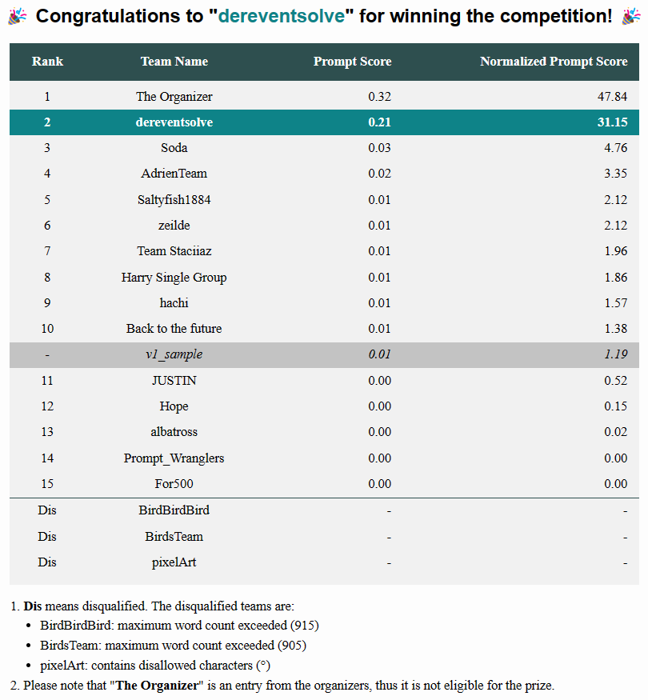
Motivation
Motivation:
Investigated prompting techniques to design a prompt
Chain of thought, self consistency, knowledge generation
Ranked last
Why?

Slide 9
Replication Experiment

Slide 10
Replication Results

Slide 11
Generalization Experiment

Slide 12
Introduction
Fine-tuning LLMs have been explored before [1][2]
Central to the recent popularity of generative AI are the affordances provided by prompting
LLMs used in PCG : prompt-based procedural content generation
Shyam Sudhakaran et al., 2023. MarioGPT: Open-Ended Text2Level Generation through Large Language Models. In Proceedings of NeurIPS 2023.
Graham Todd et al., 2023. Level Generation Through Large Language Models. CoRR abs/2302.05817 (2023).
Notes:
2024-05-13 (amy):
I put this square over the text in an attempt to try to iron out the prospective in the slides that come before it.
2024-05-09 (amy):
Affordances provided by prompting ->
We can more easily and naturally interact with level generators without needing to understand the representations for individual generators.

Slide 13
Introduction
1st ChatGPT4PCG competition at CoG 2023
Prompt engineering
Chain of thought
Self consistency
Generated knowledge
Evolving prompts
left for the future works because couldn’t be done efficiently in the current competition setting
Notes:
2024-05-09 (amy):
We should talk about the evo prompting work that we wanted to do even if we do not include it in the presentation.
It could be good to tell the narrative behind why we care about the ChatGPT4PCG competition.
Surprised by results as we were sitting in Boston 2023
You had spent a lot of time, attention, energy studying prompting (chain of thought, …, …). You also were using the tools provided by the organizers like the interface for looking at letter classification.
Thought that a score of 0 was rough and took a look at the competitor entries.
Surprised and betrayed to see that generalization had nothing to do with the success of the top prompts (The Organizer and deresentsolve)
Wanted to understand more about prompting techniques to do as well as they did.

Slide 14
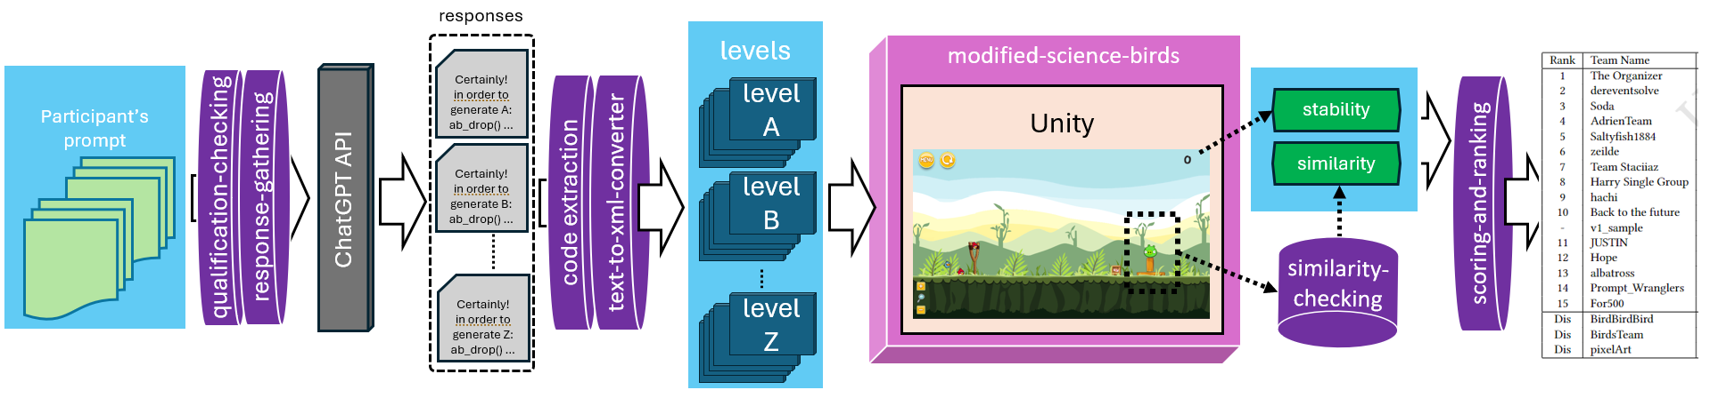
Introduction
Describe the competition: pipeline:
Qualification
Level Generation
Level Evaluation
Notes:
2024-05-09 (amy):
Competition Pipe Image ->
This image (without the yellow bottom chunks) is the way that we were understanding the competition as it was written by the organizers.
The yellow chunks at the bottom are a good addition to help think about how we started communicating the competition in the paper.
It could be helpful to summarize the competition pipeline further, perhaps with videos? idk
The ChatGPT4PCG competition calls for participants to submit prompts to ChatGPT-3.5 that then responds with
instructions to generate levels for the Science Birds physics-based game environment. These instructions are a series of commands to drop blocks at specific locations in the game, and ChatGPT-3.5 responses become XML levels through the architecture provided by the competition.
The goal is for a single prompt to generate levels that in aggregate resemble all 26 letters in the English alphabet. A single prompt generates levels that look like different letters through the template imposed by the competition design. The object variable in the prompt tells ChatGPT-3.5 which letter its instructions should generate (i.e., the target letter).
(The objective of the competition is to generate PCG levels using prompts)!
Prompts are evaluated based on the performance of ten generated levels for each of the 26 letters in the alphabet. Assuming that a prompt generates ten valid levels per letter, it is evaluated on a total of 260 levels. The scores for the prompts are based on their resemblance to the target English letters and on their in-game physical stability.

Slide 15
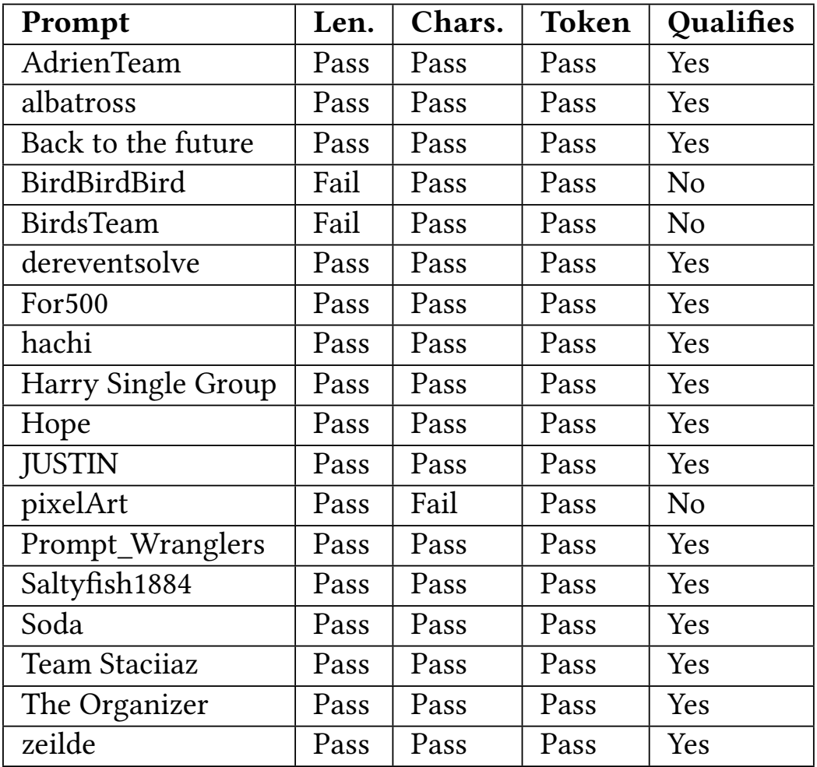
ChatGPT4PCG Competition
Word count below 900
No special characters
Prompt Qualification
Level Generation
Level Evaluation
Prompt Qualification

Slide 16
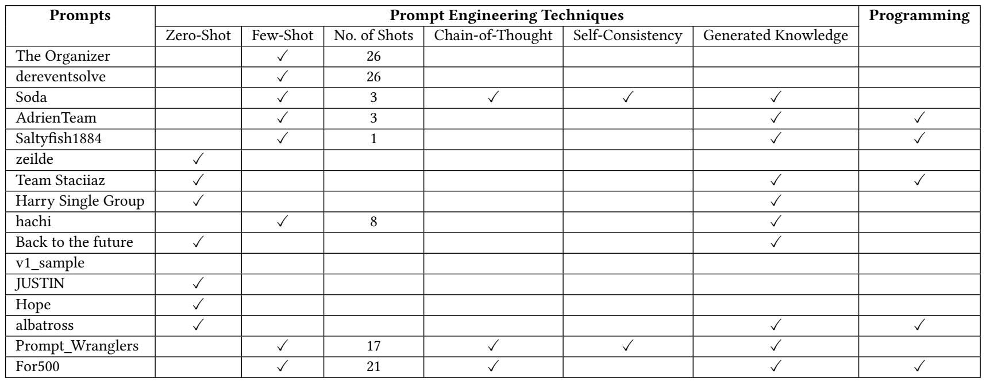
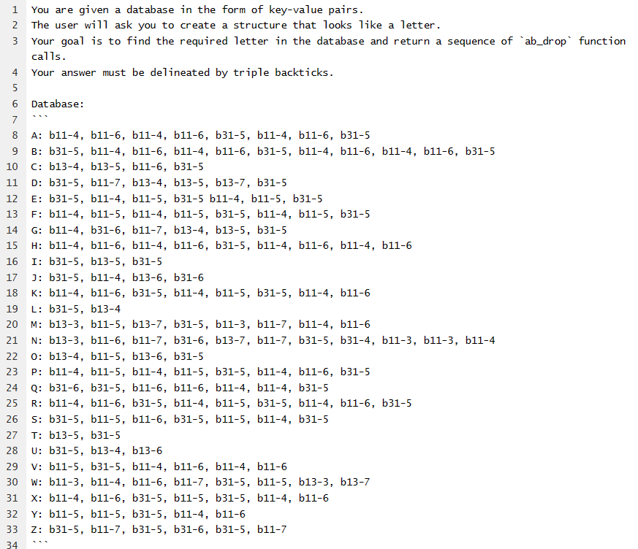
ChatGPT4PCG Competition
Prompt Qualification
Level Generation
Level Evaluation

Slide 17
ChatGPT4PCG Competition
Response Gathering
Send prompt to GPT-3.5 through the API
Code extraction: discuss the complications
Text to XML
Prompt Qualification
Level Generation
Level Evaluation

Slide 18
ChatGPT4PCG Competition
Code extraction: details
Prompt Qualification
Level Generation
Level Evaluation

Slide 19
ChatGPT4PCG Competition
Text to XML: details
Prompt Qualification
Level Generation
Level Evaluation

Slide 20
ChatGPT4PCG Competition
Modified Science Birds: details
XML file are levels in Unity
Prompt Qualification
Level Generation
Level Evaluation

Slide 21
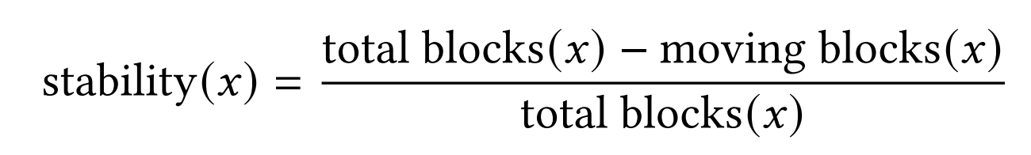
ChatGPT4PCG Competition
Stability
Prompt Qualification
Level Generation
Level Evaluation
Notes:
2024-05-09 (amy):
We don’t necessarily need this equation. It feels easier to understand for me somehow than what the ChatGPT4PCG paper does, but even better could be some combination of the 10s video clip with blocks falling and us showing visually how the scores work.

Slide 22
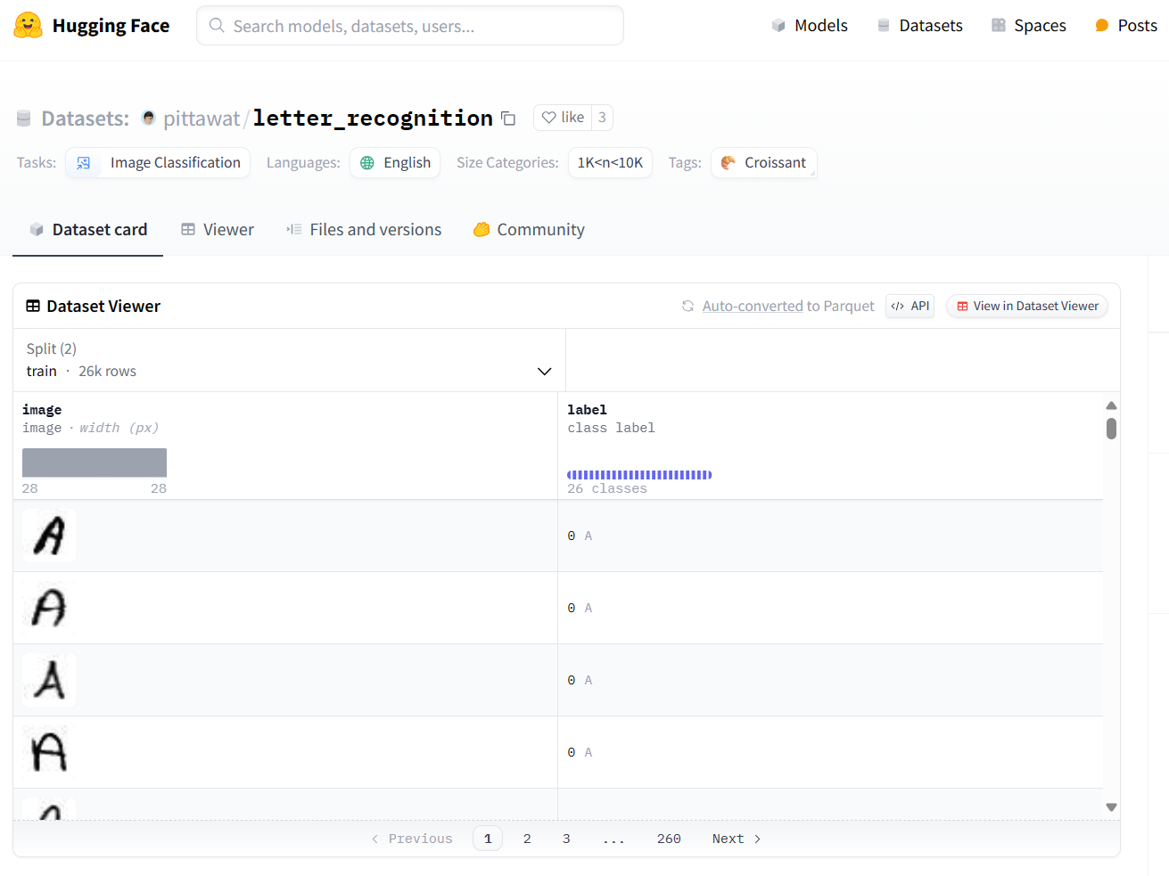
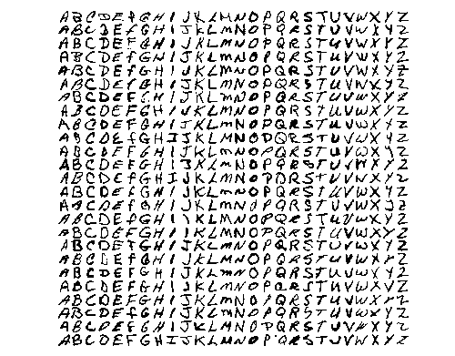
ChatGPT4PCG Competition
Similarity
A fine-tuned Vision Transformer trained on NIST Special Database 19
Prompt Qualification
Level Generation
Level Evaluation

Slide 23
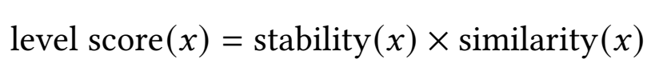
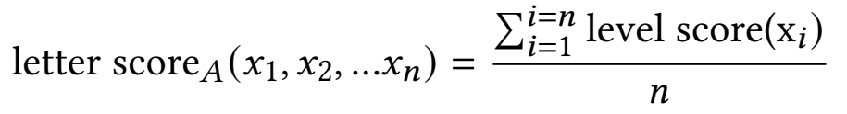
ChatGPT4PCG Competition
Score and Rank
Level Evaluation
Prompt Qualification
Level Generation
Level Evaluation

Slide 24
ChatGPT4PCG Competition
Results

Slide 25
Post Mortem
Motivation: Our first motivation was after seeing the results of the competition and seeing that our entry did not perform nearly as well as we expected. The entry Prompt_Wranglers score 0.00 in the competition.
Our first investigation was to see what the other approaches did, and then we moved on to replication of the original competition.
To our surprise Prompt_Wranglers did not score zero and managed to rank in the third place.
Notes:
Motivation: Our first motivation was after seeing the results of the competition and seeing that our entry did not perform nearly as well as we expected. The entry Prompt_Wranglers score 0.00 in the competition.
Our first investigation was to see what the other approaches did, and then we moved on to replication of the original competition.
To our surprise Prompt_Wranglers did not score zero and managed to rank in the third place.

Slide 26
Post Mortem
Prompt engineering
Chain of thought [?]
Self consistency [?]
Generated knowledge [?]
Notes:
To gain a better understanding of the prompt engineering techniques, and specially what they mean in
the context of designing a prompt for this competition, let me cover some the major approaches used:

Slide 27
Post Mortem
Notes:
This or maybe some additional slides should include entrants’ prompts to show the techniques used!
One take away from this analysis is that including prompt engineering techniques didn’t necessarily mean good performance, on the contrary the simplest approach of developing a lookup table was the best approach.

Slide 28
Post Mortem
To investigate more in depth, we designed two sets of experiments:
Replication
Generalization
Incorporating RAW score
Notes:
Here, we target the components/parts of the competition pipeline that we targe for our analyses
Two sets of experiments are proposed. The replication experiment investigates whether
the original prompts achieve approximately the same scores six months after the competition.
ChatGPT-3.5 is closed source and it is unclear when changes are made that may impact the generated levels.
This experiment also examines whether scores are impacted by increasing the number of levels generated per letter to 100. The results of the replication experiment
show that ChatGPT-3.5 is changing over the time span of six months, and that these small changes can significantly impact how prompts score, whether ten or 100 levels are evaluated. While the sample size is likely adequate for the competition, to make conclusions
about prompts submitted to the competition over the course of years, it will be important to query LLMs with static weights.

Slide 29
Experiments
Describe the experiments
Replication: The replication experiment investigates whether the original prompts achieve approximately the same scores six months after the competition (N=10)
Motivation: ChatGPT-3.5 is closed source and its unclear that the changes made to this model could change the generated levels.
Next: motivation, is n=10 enough for accounting the stochasticity of GPT-3.5?
N=100
Notes:
Two sets of experiments are proposed. The replication experiment investigates whether
the original prompts achieve approximately the same scores six months after the competition.
ChatGPT-3.5 is closed source and it is unclear when changes are made that may impact the generated levels.
This experiment also examines whether scores are impacted by increasing the number of levels generated per letter to 100. The results of the replication experiment
show that ChatGPT-3.5 is changing over the time span of six months, and that these small changes can significantly impact how prompts score, whether ten or 100 levels are evaluated. While the sample size is likely adequate for the competition, to make conclusions
about prompts submitted to the competition over the course of years, it will be important to query LLMs with static weights.

Slide 30
Experiments
Describe the experiments
Generalization: comes from the goal of PCGML [1]
Motivation: the generalization experiment examines the ability of prompts to generate levels it has not yet seen (i.e., that are not hard-coded in the prompt).
zero-shots -> the ability of prompts to generate levels it has not yet seen
one-shot -> some letters are more difficult to generate than others
N-shots -> The goal of this experiment is to understand whether successful prompts are generalizing or if it is the quality of their lookup tables that determines their score.
Adam Summerville et al. 2018. Procedural content generation via machine learning (PCGML). IEEE Transactions on Games 10, 3 (2018), 257–270.
Notes:
The generalization experiment examines the ability of prompts to generate levels it has not yet seen (i.e., that are not hard-coded in the prompt). Prompts are modified to contain zero-shots or example letters in the zero-shot setting or one-shot in the one-shot setting. The prompts in the one-shot setting are tested per letter given that prompts contain different example letters and some letters are more difficult to generate than others.
N-shot prompting is specified for a small subset of prompts and example letters. The goal of this experiment
is to understand whether successful prompts are generalizing or if it is the quality of their lookup tables that determines their score. Results show that these modified prompts perform significantly worse
than their unmodified counterparts and prompts that generalize well are not necessarily those that perform well in the competition. These results suggest that generalizing with these new level generators is an open problem to explore.

Slide 31
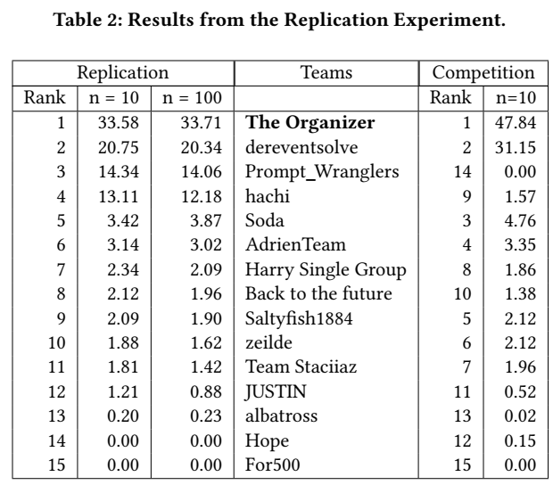
Experiments
Replication
N=10 with the aim of replication of the original competition
N=100 to see if N=10 is enough to assess the quality of the prompts
Notes:
replicating the competition results tests the entire pipeline: whether ChatGPT produces the same responses now as it did a few months ago, whether the scripts run the same in our computational environment
as on the organizers’ machines

Slide 32
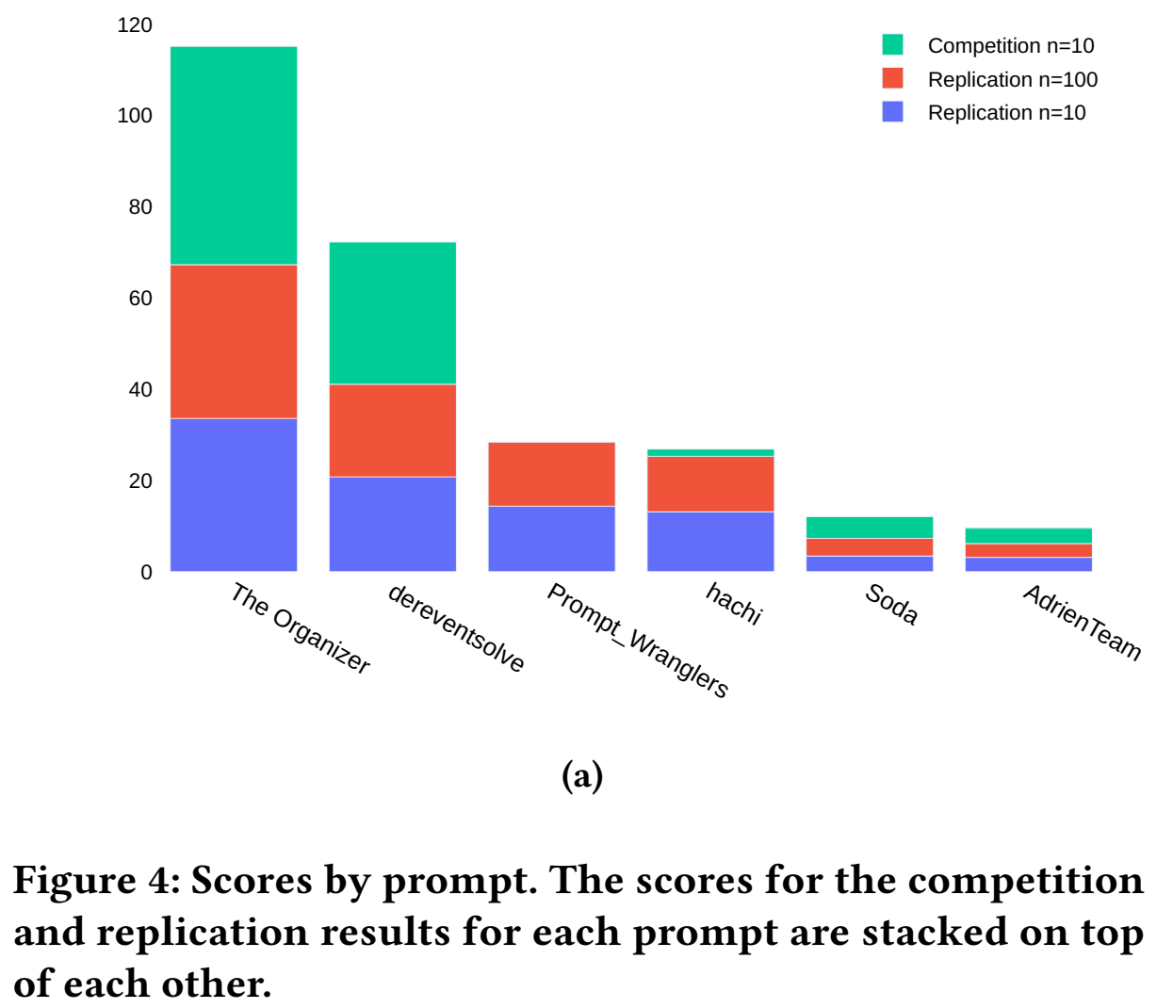
Experiments
Replication
N=10 with the aim of replication of the original competition
N=100 to see if N=10 is enough to assess the quality of the prompts
Notes:
2024-05-09 (amy):
Make sure that when you present any of the figures that you explain what the audience is looking at before diving into a discussion of the results.
replicating the competition results tests the entire pipeline: whether ChatGPT produces the same responses now as it did a few months ago, whether the scripts run the same in our computational environment
as on the organizers’ machines

Slide 33
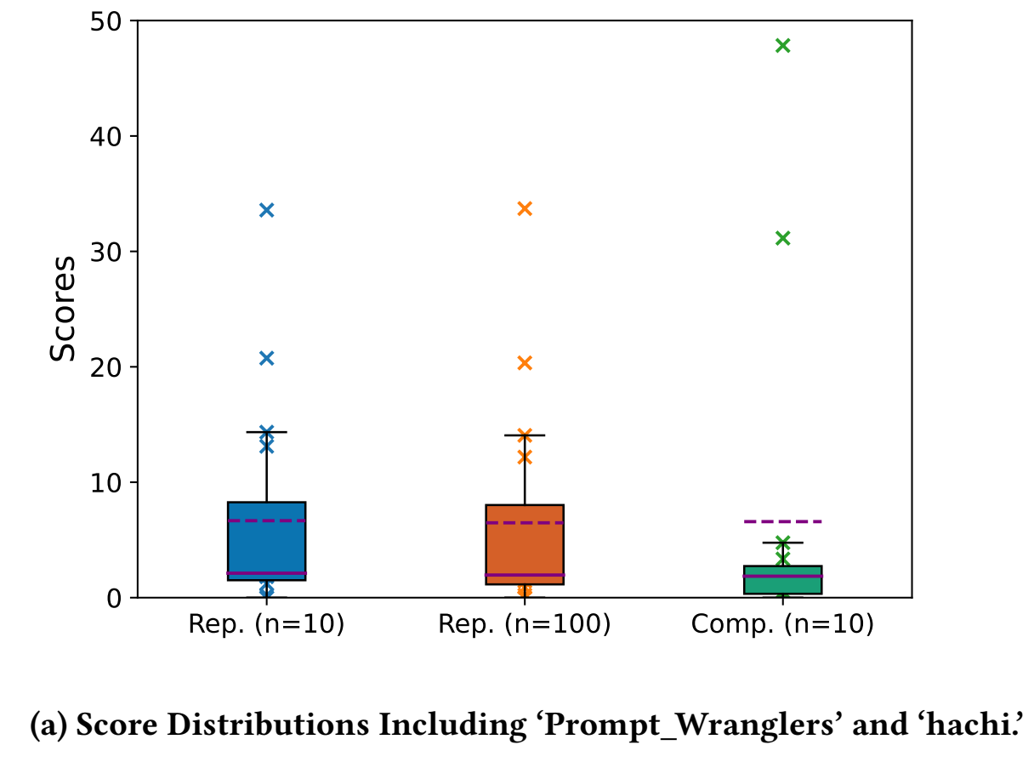
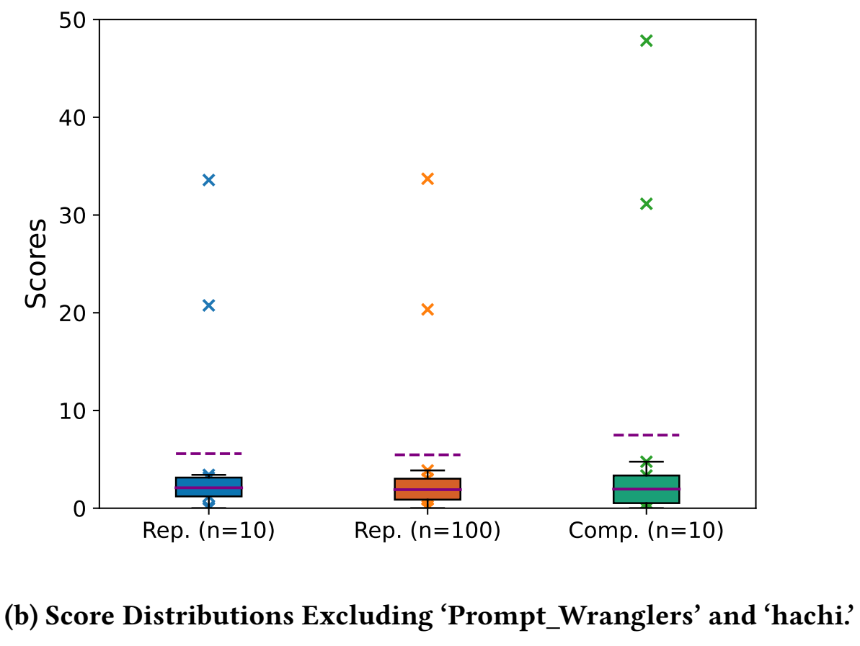
Experiments
Replication
Notes:
2024-05-09 (amy):
Make sure that when you present any of the figures that you explain what the audience is looking at before diving into a discussion of the results.
Score Distributions for the Replication and Competition Results. For each distribution, the outliers are scores for ‘The Organizer’ and ‘dereventsolve.

Slide 34
Experiments
Generalization
RAW score
We should target people who may have reviewed our paper and are in our audience by talking about the scripts that Mark edited that helped us make our results comparable between figures/runs.
Also important for the QE.
Notes:
2024-05-09:
Mark’s Edits to Arash’s Script:
Commit History:
https://github.com/gaimes-njit/gaimes-njit.github.io/commit/2f16d732c9fff2bf26a49fd15b6ecb4bd64ec141
https://github.com/gaimes-njit/gaimes-njit.github.io/commit/7593d40f63f5e0bcd0014051d5f0e6827771aa29
Files:
publications/fdg_pcg24/arash_moradi_karkaj/figures/generalization/zero_shot_table.py
publications/fdg_pcg24/arash_moradi_karkaj/figures/generalization/generalization_figure_nshot.py
An important difference in scoring for the generalization experiment results
is that all reported scores are raw scores. The competition’s scoring process
includes two “dynamic” aspects – weighting and normalization – that make
scores incomparable across experiments (or different iterations of the competition).
Per letter scores are weighted to give more weight to harder letters and
less weight to easier letters (easier/harder measured by how well
prompts do). The weighted scores are then normalized by dividing
each prompt’s score by the sum of all prompt scores and multiplying
by 100, effectively making the final score a percentage (all scores in
the competition total to 100). To make scores comparable between
different experiments, a new metric called raw score is introduced.
It removes the dynamic aspects of the original competition: letters
are equally weighted, and there is no normalization (summarized
in Section 2.3)

Slide 35
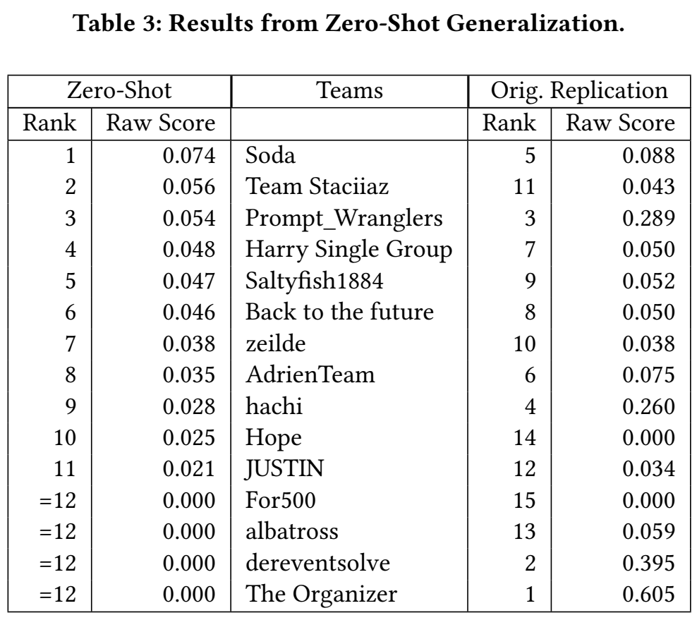
Experiments
Generalization
Zero-Shot Generalization: zero-shot prompting means building a prompt that can include any amount of general discussion, but excludes explicit drop sequences for any letters
Example
Notes:
Zero-Shot Generalization tests generalization when prompts explain how levels should be generated without referencing example solutions.
The original competition prompts are modified to exclude any example instructions for letters. The zero-shot generalization test
is a strong test of generalization, and it is a common way to test generalization in the LLM evaluation literature. In the ChatGPT4PCG case, zero-shot prompting means building a prompt that can include any amount of general discussion, but excludes explicit drop sequences for any letters.

Slide 36
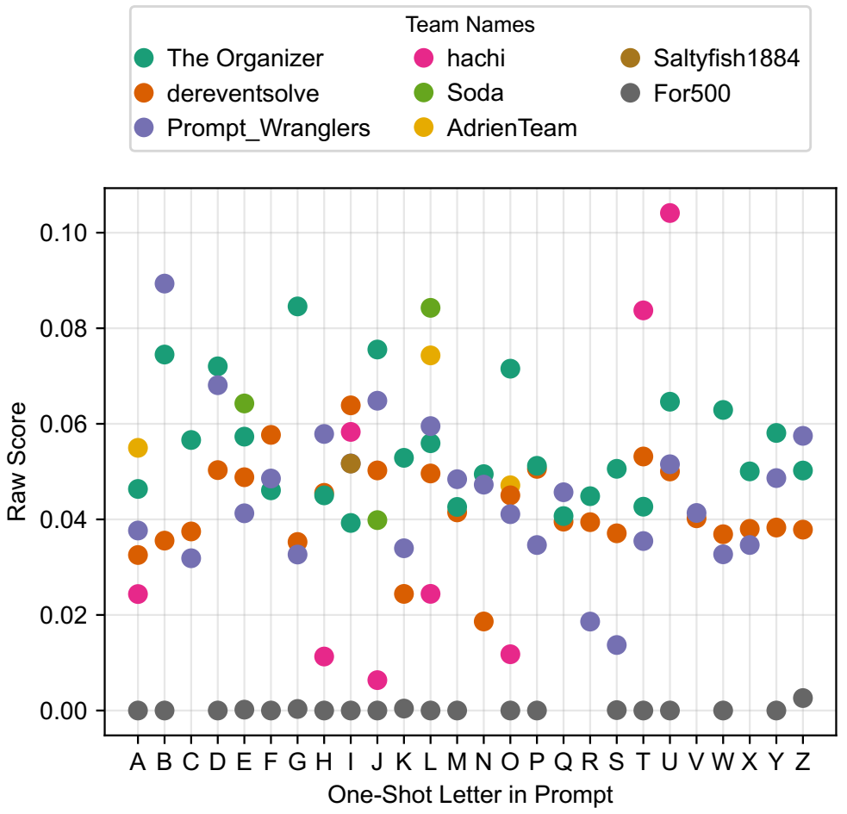
Experiments
Generalization
One-Shot Generalization
Notes:
2024-05-09 (amy):
Make sure that when you present any of the figures that you explain what the audience is looking at before diving into a discussion of the results.
One-Shot Generalization is a common way to prompt LLMs that are expected to generalize from one example solution. It is a strong test of generalization, but weaker than the zero-shot setting which is expected to generalize to other cases without an example solution. In this experiment, 26 modified versions of all competition entries are tested, one for each possible choice of one-shot letter. We modified the original prompts to remove any explicit solutions other than the one letter being tested each time. While some submissions have an example for each of the letters (namely The Organizer and dereventsolve), the rest include partial examples, so in some cases this results in the modified prompts actually being zero-shot. In those cases we excluded them from the results presentation.
Figure 6: Results of the One-Shot Generalization Experiment. A subset of prompts include instructions for generating specific letters, and the performance for a prompt is shown only for prompts that contain the given shot-letter.

Slide 37
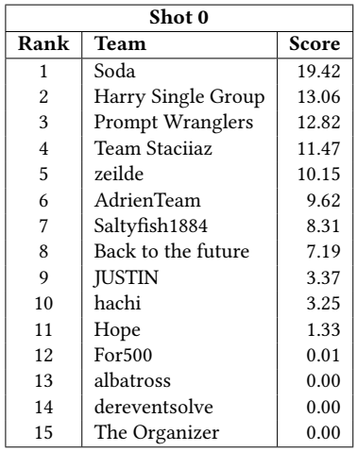
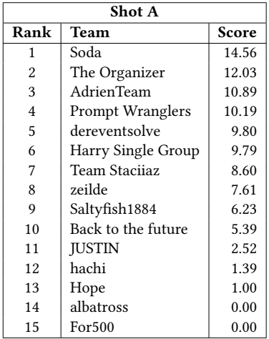
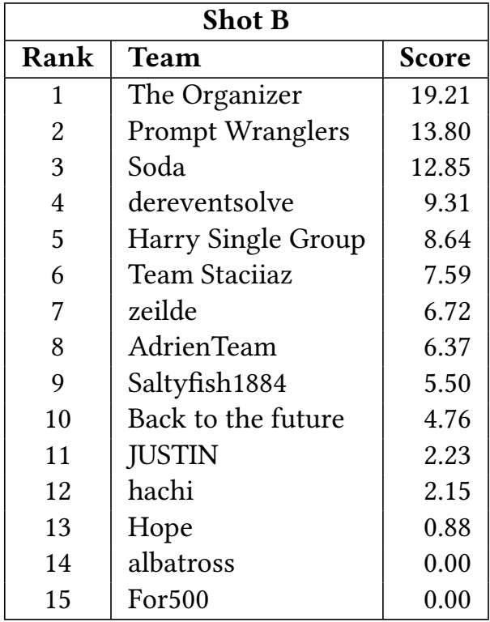
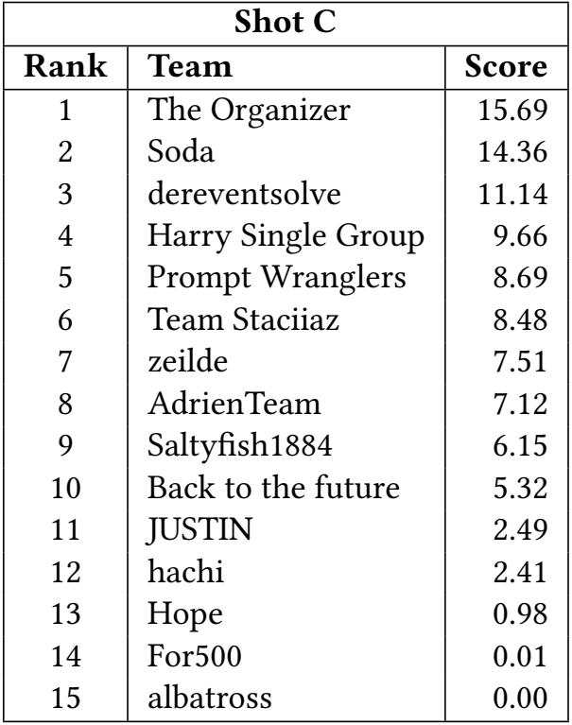
Experiments
Generalization
One-Shot Generalization
Notes:
One-Shot Generalization is a common way to prompt LLMs that are expected to generalize from one example solution. It is a strong test of generalization, but weaker than the zero-shot setting which is expected to generalize to other cases without an example solution. In this experiment, 26 modified versions of all competition entries are tested, one for each possible choice of one-shot letter. We modified the original prompts to remove any explicit solutions other than the one letter being tested each time. While some submissions have an example for each of the letters (namely The Organizer and dereventsolve), the rest include partial examples, so in some cases this results in the modified prompts actually being zero-shot. In those cases we excluded them from the results presentation.
Figure 6: Results of the One-Shot Generalization Experiment. A subset of prompts include instructions for generating specific letters, and the performance for a prompt is shown only for prompts that contain the given shot-letter.

Slide 38
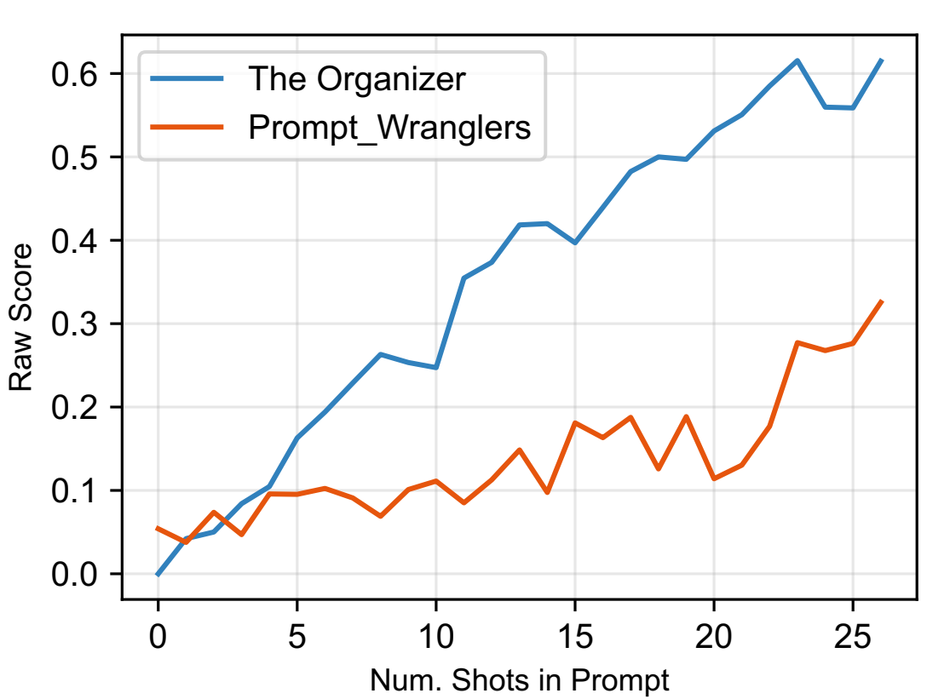
Experiments
Generalization
N-Shot Generalization
Notes:
2024-05-09 (amy):
Make sure that when you present any of the figures that you explain what the audience is looking at before diving into a discussion of the results.
N-Shot Generalization is based on the modified versions of ‘The Organizer’ and ‘Prompt_Wranglers’. This experiment varies the number of examples (“shots”) given, from zero (as in the
Zero-shot prompting experiment) all the way up to 26 (as in the top two entries in the original competition). The experiment intends to investigate generalization along a continuum from zero example solutions provided in the prompt to all 26 example letters. The experiment starts by removing all shots from the prompts, and slowly reintroducing examples for the letter ‘A,’ then ‘A’ and ‘B’, iteratively adding letters until all 26 shots are provided in each prompt.
Figure 7: Results of the N-Shot Generalization Experiment. The number of shots N ranges from 0 at the left to 26 at the right. These experiments test two prompts: ‘The Organizer’ and ‘Prompt_Wranglers’

Slide 39
Discussion
Results of the experiments suggest that it is possible to design a replicable competition by carefully selecting the LLM to query and that in the ChatGPT4PCG competition, ChatGPT-3.5 is memorizing from the examples provided in prompts rather than generalizing. Redesigning prompt-based PCG competitions and investigating prompt generalization are both rich areas for future work.

Slide 40
Discussion
Figure 8 shows the scores calculated for 𝑛 = 100 responses per letter per prompt. It separates the stability and similarity scores for the competition entries with the weightings removed to reduce ambiguity. While most prompts score around 80% or above in stability score shown in the bottom chart, most prompts score between zero and 20% in similarity. In fact there is a sense in which rank differences are nearly entirely decided by similarity scores.

Slide 41
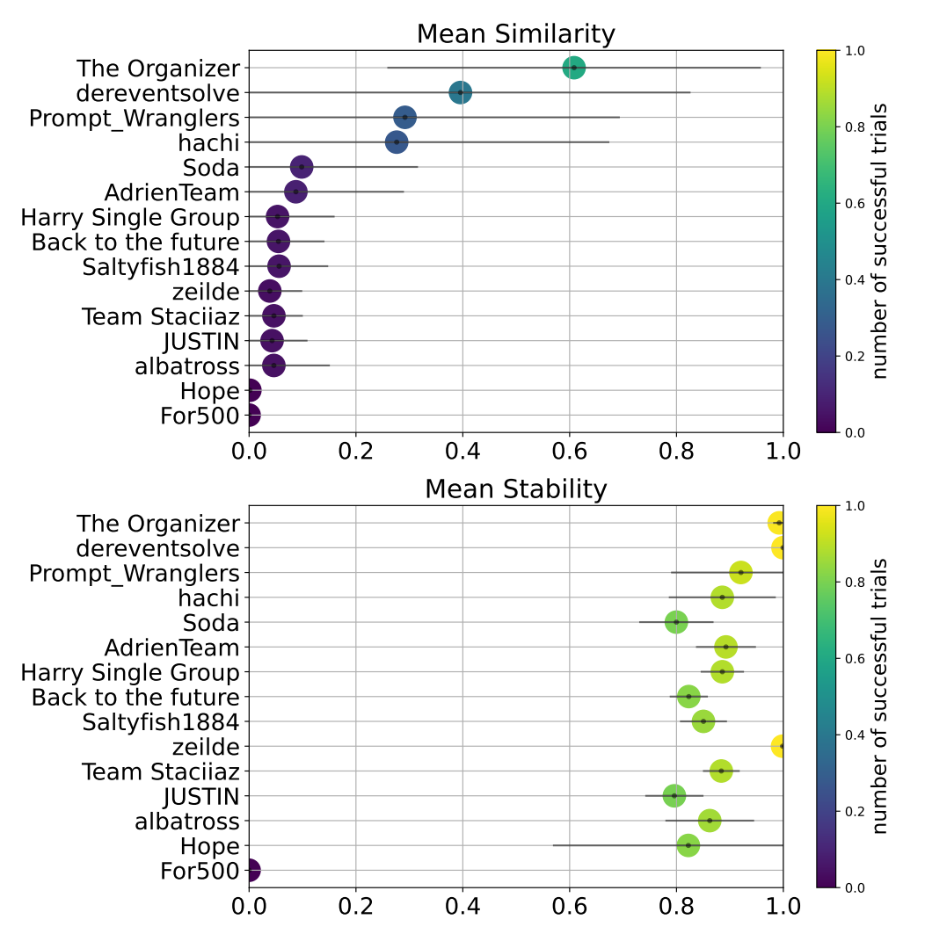
Discussion
Figure 8 shows
Notes:
Figure 8 shows the scores calculated for 𝑛 = 100 responses per letter per prompt. It separates the stability and similarity scores for the competition entries with the weightings removed to reduce ambiguity. While most prompts score around 80% or above in stability score shown in the bottom chart, most prompts score between zero and 20% in similarity. In fact there is a sense in which rank differences are nearly entirely decided by similarity scores.

Slide 42
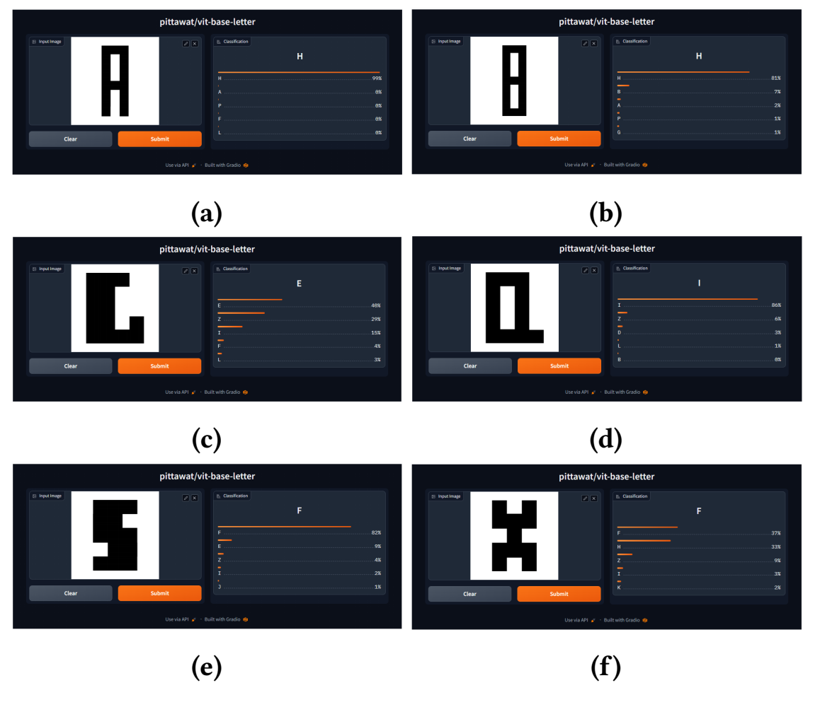
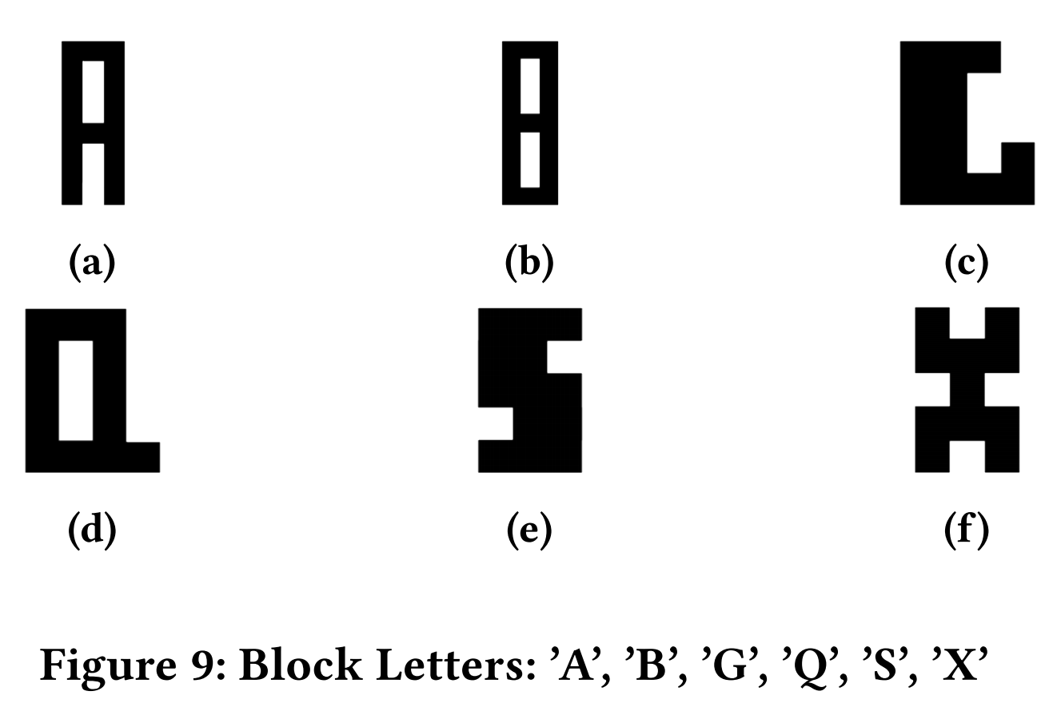
Discussion
Misclassification due to using a collection of handwritten letters
Notes:
However the top-ranked prompt designed by the organizers of the competition achieves only a 60% average similarity score. One possible cause for the low similarity scores may be due to the training data, which is a collection of handwritten letters. Figure 9 shows block letters clearly representing ’A’ and ’B,’ yet the softmax probability of these target letters is 0.00 for ’A’ and 0.07 for ’B.’ These letters would both be classified as H with probability 0.99 and 0.81 percent chance. Similarly, the block letter G is assigned a 0.40 chance of being an ’E’, 0.29 chance of ’Z’, 0.15 chance of I, and 0.04 chance of F. While the letter ’C’ would be a reasonable mistake, neither ’G’ nor ’C’ are recognized with any probability. The classifier is similarly confused with ’X’, guessing 0.37 chance of ’F’, 0.33 chance of ’H’, 0.09 ’Z’, 0.03 ’I’, and 0.02 ’K.’ Given the chances of misclassification, score is likely largely impacted by the quality of the classifier. Future work will address training a classifier on a more appropriate dataset for the task.

Slide 43
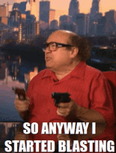
Discussion
Controllability
Large
Language
Model
prompt

Slide 44
Conclusion
1
Notes:
This paper takes a deep-dive into the ChatGPT4PCG competition and explores whether the competition is replicable and whether prompts are generalizing or simply giving to ChatGPT-3.5 a memorization cheat-sheet.
For the replication experiment, the competition code is run locally and six months after the competition was held. While many prompts earn similar scores, two of the 15 ranked entrants do considerably better in the replication experiment than in the original competition. One reason for the improved performance is the number of valid levels that could be generated and scored. The ‘Prompt_Wranglers’ prompt was missing important template information in ChatGPT-3.5 responses that led to generating invalid levels and a score of 0.00. This score was part of what motivated the replication study

Slide 45
Conclusion
2
Notes:
In the generalization experiment, the number of example solutions provided in the prompts is varied by analogy to the concept of few-shot prompting in the LLM literature. The best-performing prompt in the original competition included 26 explicit solutions, which reduces level generation to selecting one of 26 promptprovided
answers rather than generalizing to new, unseen problems. When restricted to the few-shot setting, the prompts score lower than they did in the competition. We conclude that generalization in prompt-based PCG remains an open problem. One takeaway from this study is that future prompt-based PCG experiments should be designed to test generalization as a goal of the competition.

Slide 46
Conclusion
3
Notes:
Finally, replicating results is problematic for a competition that
queries a public, closed-source LLMs such as ChatGPT: Many things
can change, and it is difficult to isolate variables. Our replication
experiments, despite reusing the competition scripts, found much
better performance with two of the fifteen non-disqualified prompts
that were submitted to the first ChatGPT4PCG competition, when
compared to the official results. Since one of these prompts was our
submission, we were able to analyze it in more detail and attempt
to understand reasons for the discrepancy. But we were unable
to similarly conclude with any confidence why the other prompt,
‘hachi’, scored much better in our replication than in the original
competition. Our suggestion is that that researchers using LLMs,
especially closed API-based LLMs, for prompt-based PCG research
may wish to save and document (at least in online supplemental
material) more details of the experiments than has been typical,
perhaps even erring on the side of pedantically hoarding all inputs
and outputs whatsoever. For example, if in addition to the prompts,
we had all ChatGPT responses as run at the time of the competition,
we would have been more easily able to compare original responses
to responses in our attempted replication.

Slide 47
Recommendations and Future Work
1
2
3
…

Slide 48


